Slide 1
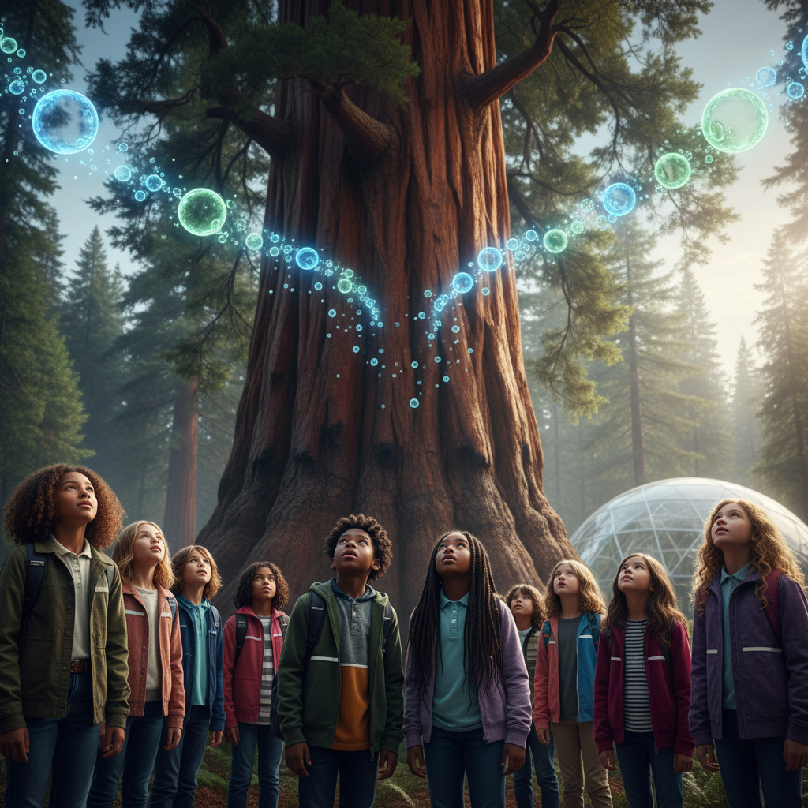
ModelIt!
Student Lesson
Where Does a Tree's Mass Come From?
A 1-Ton Tree Got Most of Its Weight From Air
NGSS: 5-LS1-1
5th Grade
1/9

Slide 2
What You Will Learn Today
Learning Goals
* Explain that plants get most of their mass from CO2 in the air, not soil
* Model how CO2 and sunlight drive photosynthesis
* Trace how photosynthesis converts air into tree mass
* Predict what happens to tree growth when CO2 or sunlight is removed
Key Vocabulary
Photosynthesis
The process plants use to convert light, CO2, and water into sugar
CO2 (Carbon Dioxide)
The gas plants use as raw material for growth
Biomass
The total mass of living material in an organism
Glucose
The sugar produced by photosynthesis - plant food and building material
2/9

Slide 3

The Big Question
Where does a tree get the materials it needs to grow?
A 1-Ton Tree Got Most of Its Weight From Air. Today we'll build a MODEL to discover the answer!
3/9

Slide 4

Today We Will Build a Model!
A model helps us understand complex systems!
1. LOCATE
Identify the COMPONENTS (parts) of the system
2. ESTABLISH
Connect them with RELATIONSHIPS (+ or -)
3. VISUALIZE
Build your model in ModelIt!
4. EVALUATE
Run SIMULATIONS to test scenarios
5. REVISE
Improve your model based on evidence
4/9

Slide 5

Activity 1: Sort the Components
Sort these components into EXTERNAL (inputs from outside) and INTERNAL (inside the system):
Your Components:
* CO2 in Air
* Sunlight
* Photosynthesis Rate
* Tree Biomass
Think: Which components can we control? Which happen on their own?
5/9

Slide 6
Activity 2: Connect with Arrows
Draw arrows to show HOW components affect each other:
(+) POSITIVE Relationship
When one goes UP, the other goes UP too
(-) NEGATIVE Relationship
When one goes UP, the other goes DOWN
Think About It:
If trees don't get mass from soil, where do the carbon atoms in wood come from?
6/9

Slide 7
Activity 3: Run the Simulation!
Test these scenarios in ModelIt!
Normal Growth
CO2 and Sunlight at normal levels
No CO2
Lock CO2 to 0% - sealed environment
Greenhouse Boost
Both CO2 and Sunlight at high levels
Watch the activity graphs change!
[ModelIt Platform Screenshot - Simulation Results Graph]
7/9

Slide 8
What Did We Discover?
Our Model Showed Us:
* Trees get most of their mass from CO2 in the air - not from soil
* Soil provides minerals but not the bulk mass of the tree
* Remove CO2 and tree growth stops completely
* This is why deforestation releases stored carbon back to atmosphere
Answer: Trees get their mass from carbon dioxide in the AIR! They pull CO2 through their leaves and use photosynthesis to build it into solid wood.
8/9

Slide 9
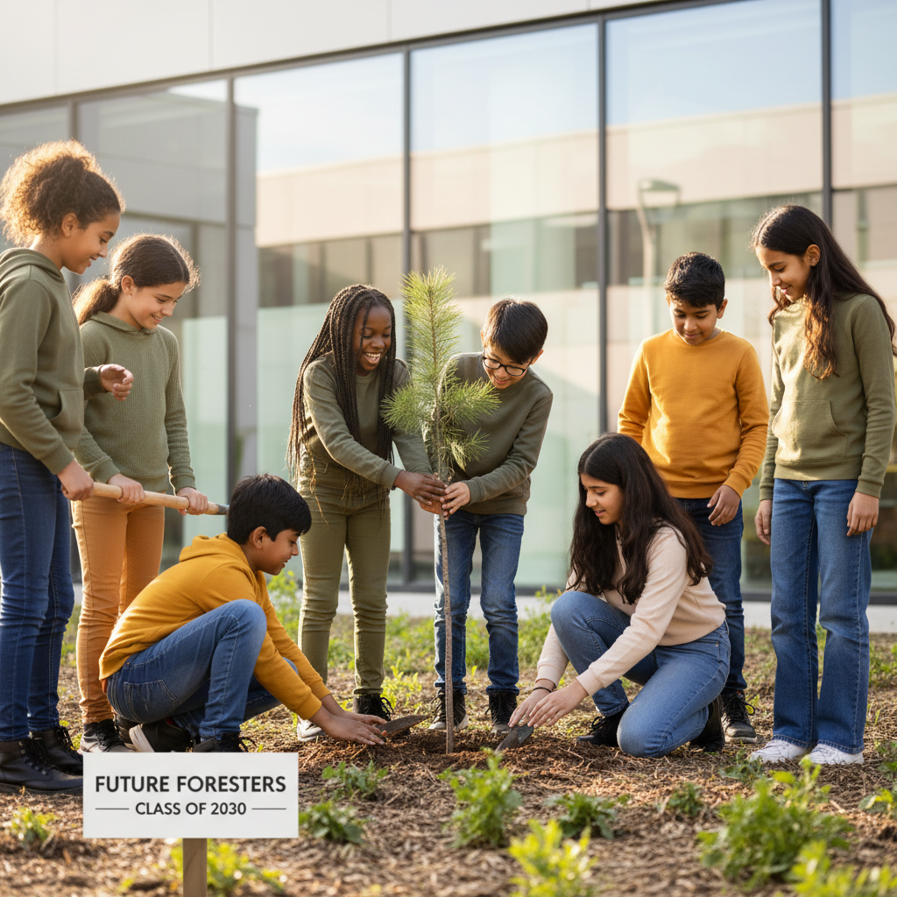
STEM Challenge: Design a Carbon Capture Forest
YOUR ENGINEERING MISSION
Design a reforestation project to capture the most CO2 possible.
The Challenge:
Your city wants to offset carbon emissions by planting trees. Design the most effective carbon capture forest.
Think Like an Engineer:
* Which tree species capture the most CO2?
* How much CO2 does one tree absorb per year?
* Where should the forest be located for maximum growth?
REAL CAREER CONNECTION: Plant Biologists and Agricultural Scientists optimize photosynthesis to feed 8 billion people. They earn $65,000-$105,000/year. The skills you're using TODAY are the same ones they use on the job!
9/9

